Slide 1


Slide 2


Slide 3


Slide 4
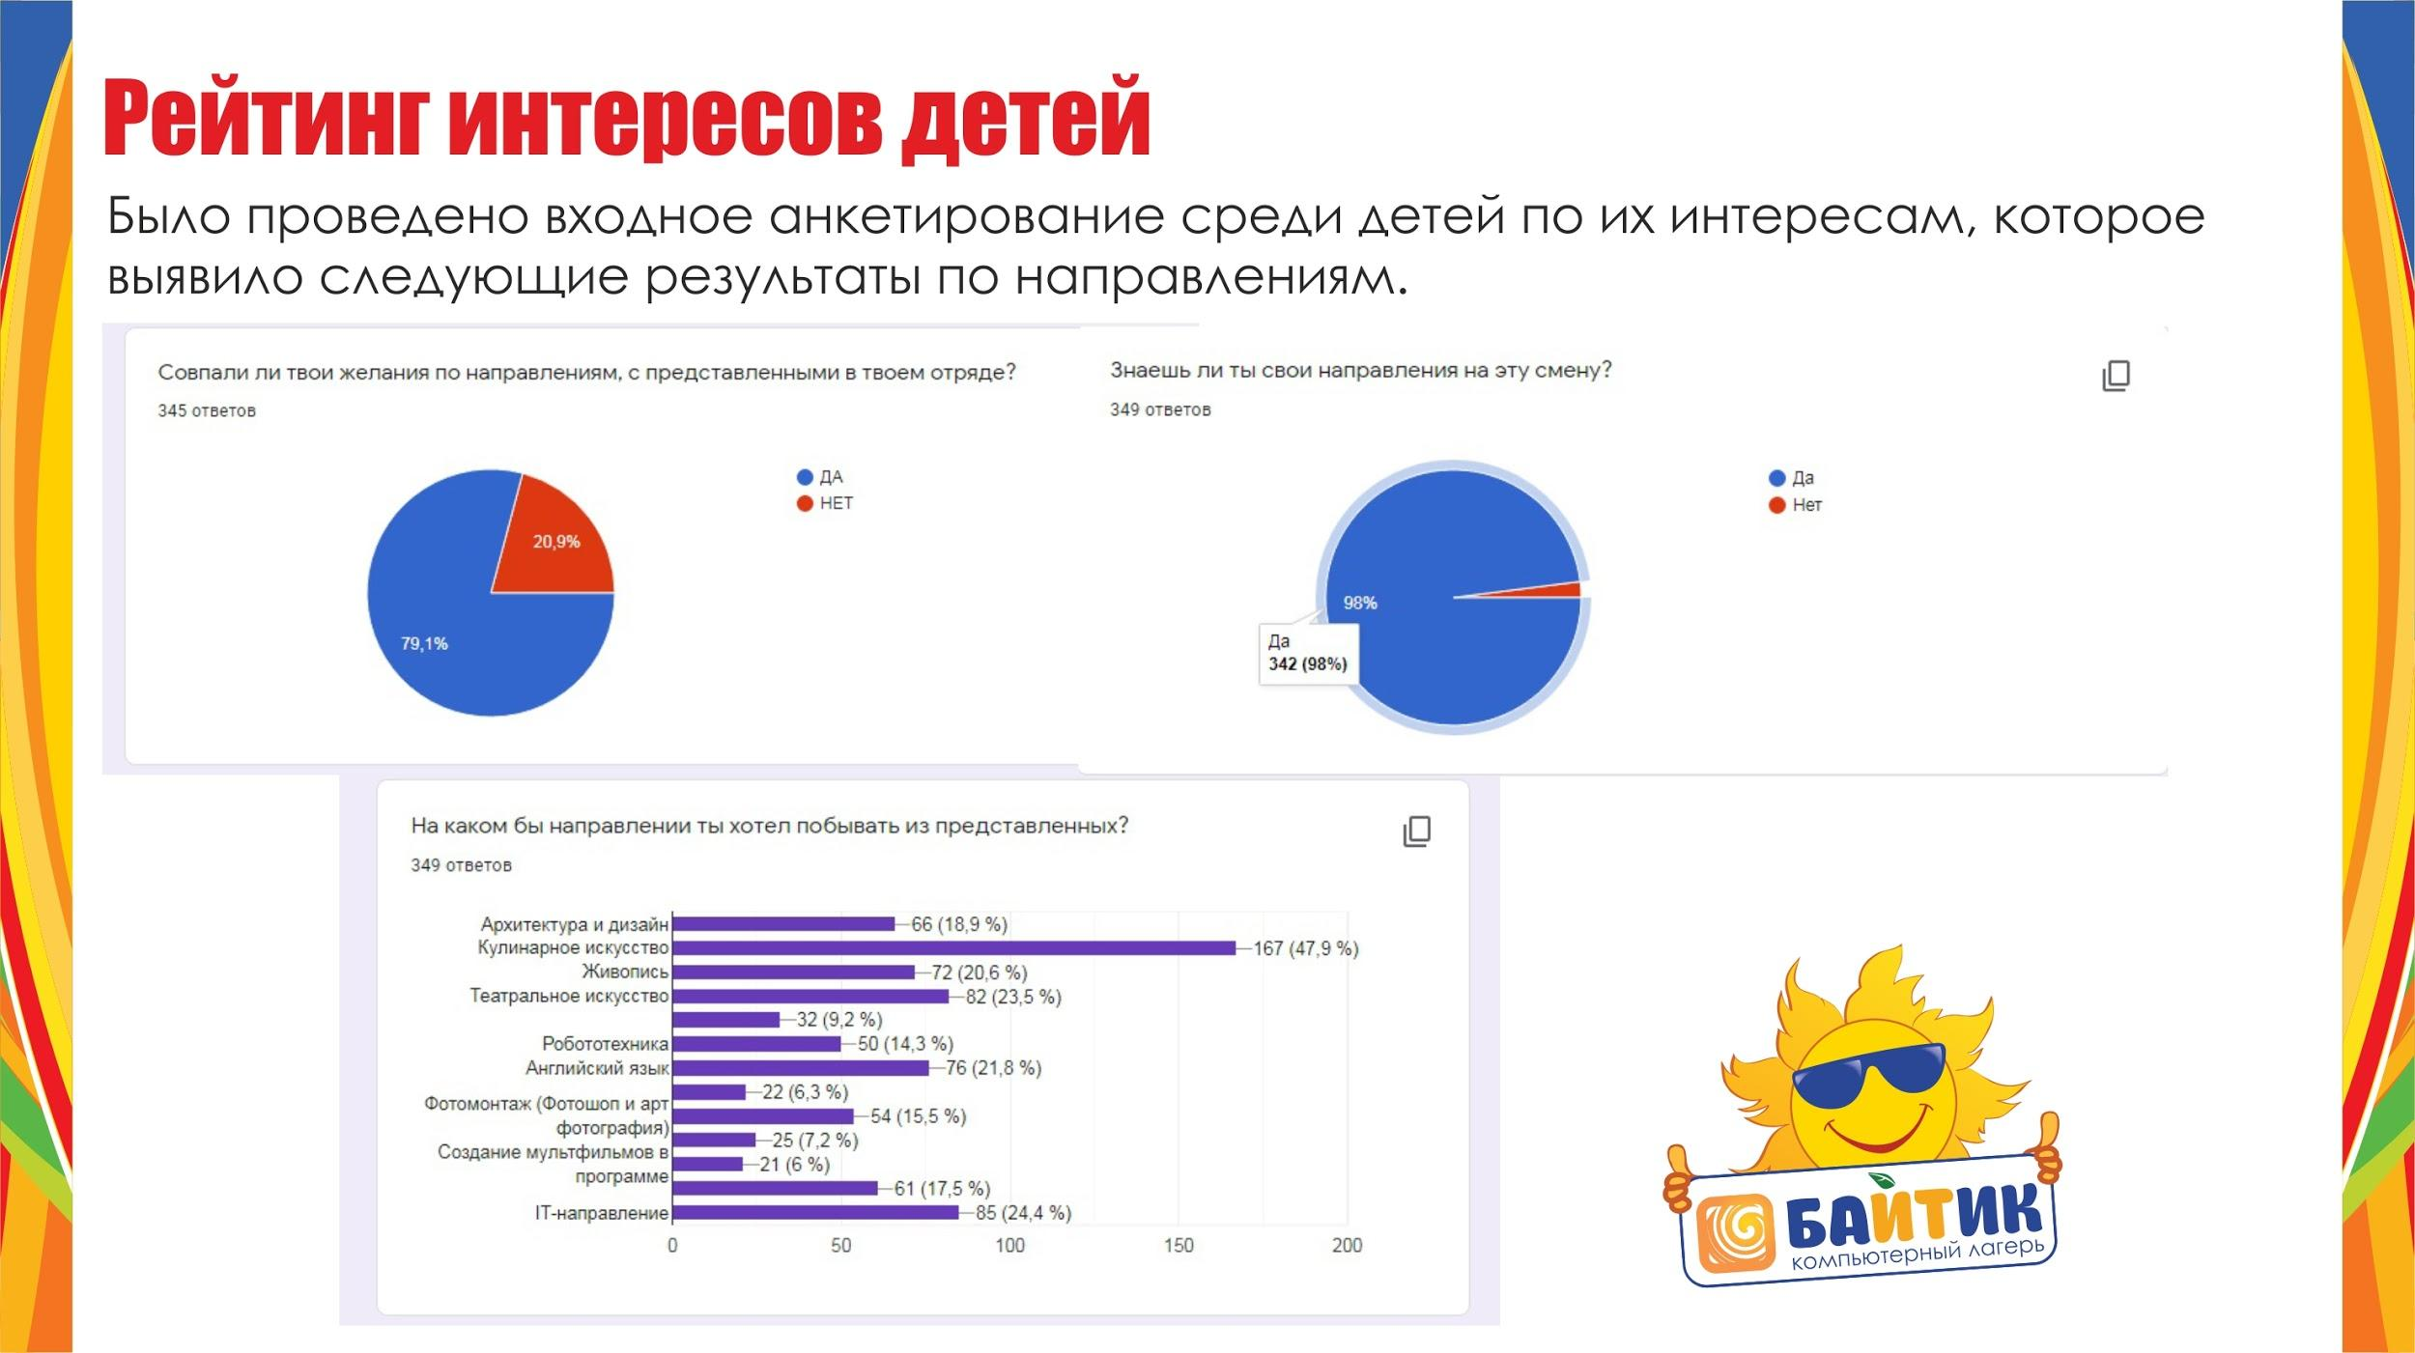

Slide 5
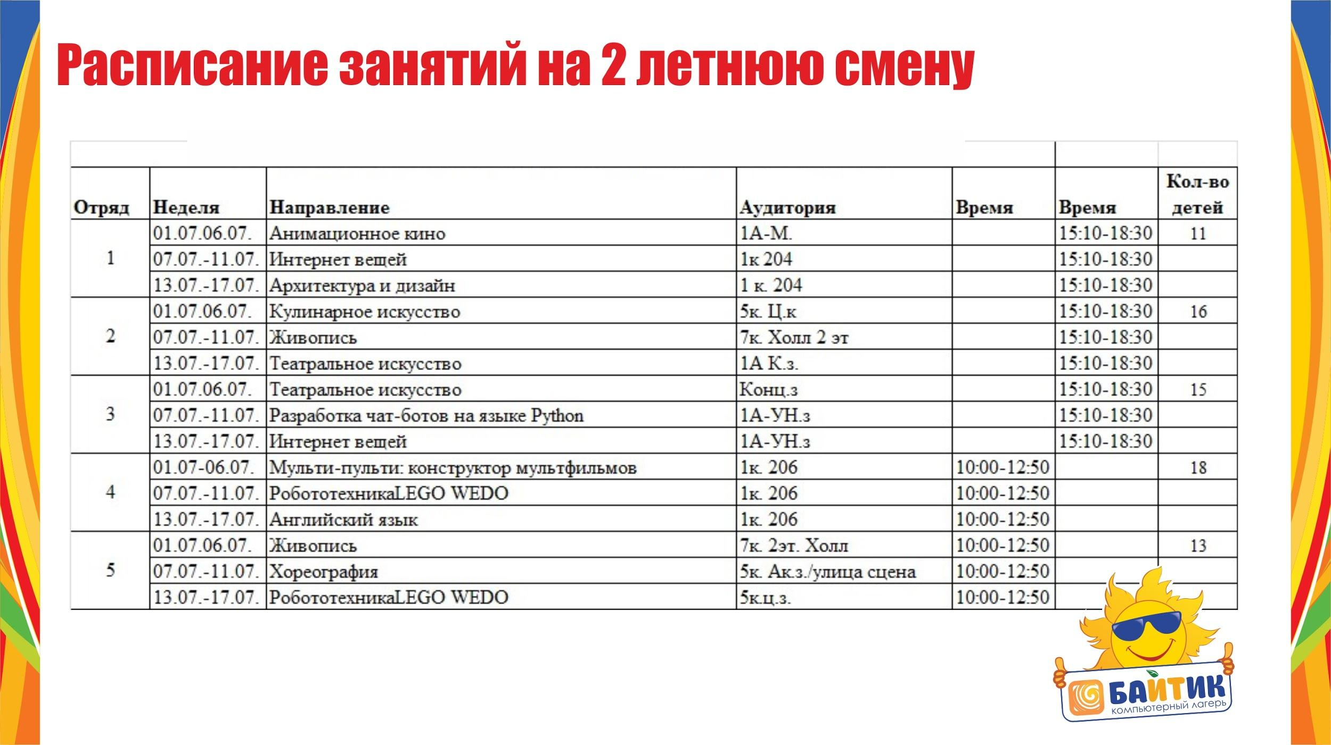

Slide 6
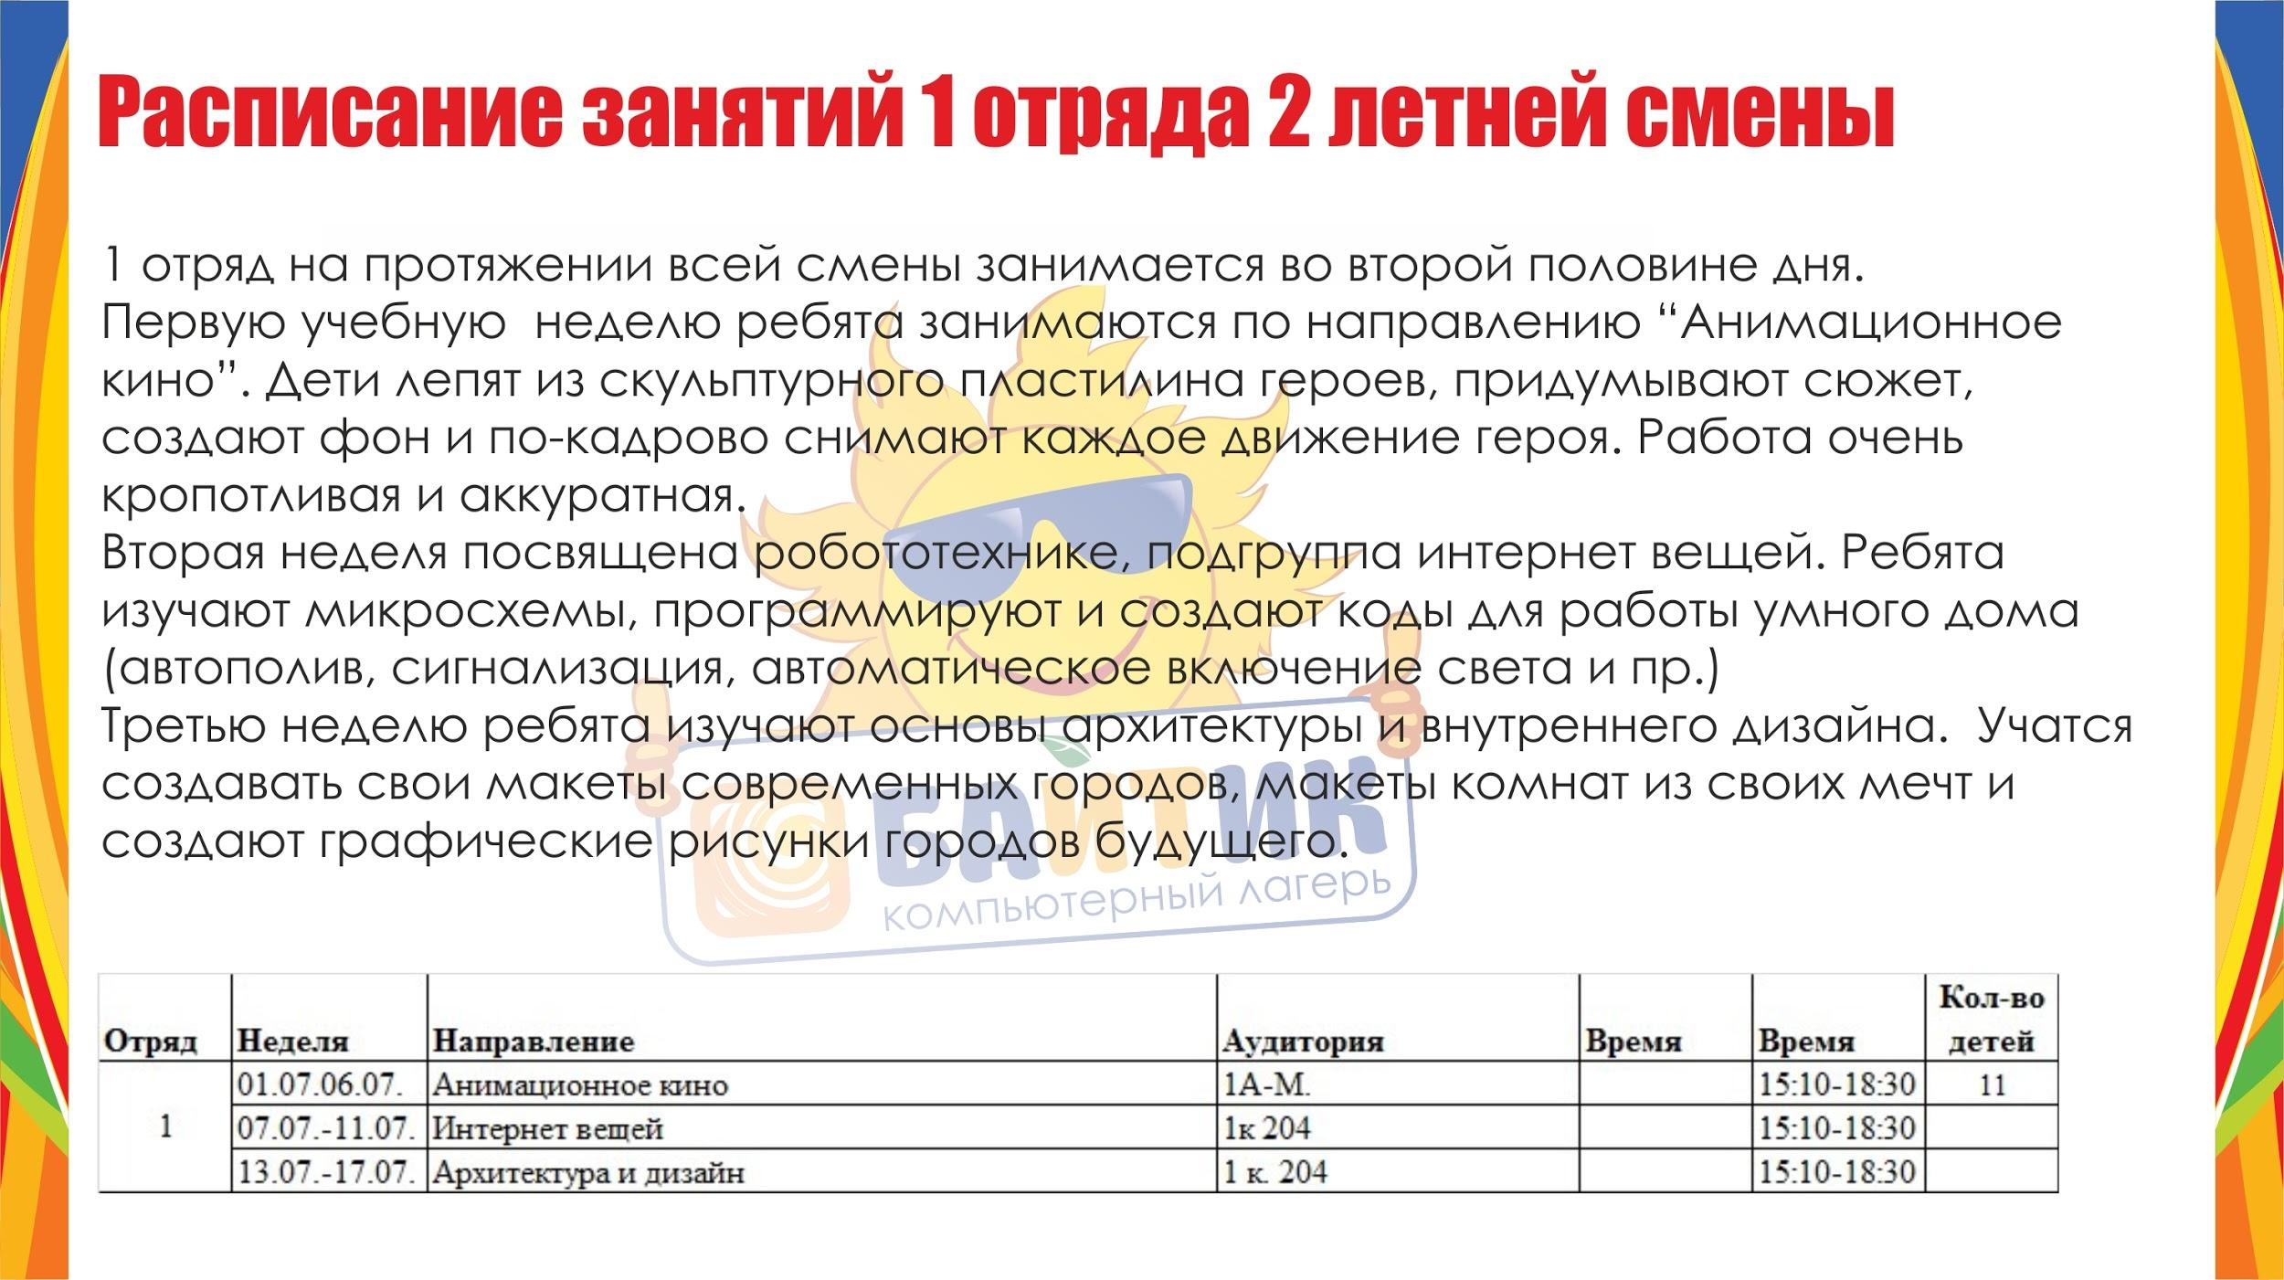

Slide 7

https://drive.google.com/drive/folders/1uziJU5OHDtvFy-fyZms8dgqyOkflluYT?usp=sharing

Slide 8

Интернет вещей
https://drive.google.com/file/d/1WPSGoNdM0JCZCgeBjMIfNaRKbdIt1pK7/view?usp=sharing

Slide 9

https://drive.google.com/drive/folders/1iXrZwQpsxX-qMgFTIJeVV4Eu-J4thDBN?usp=sharing

Slide 10

https://drive.google.com/drive/folders/1mHw-4vZeucOPTdWi9BxCfeIbB7ve_H21?usp=sharing

Slide 11


Slide 12


https://drive.google.com/drive/folders/1bDSYap4LlFGFDf70qd92KcBWa4wKT5AY?usp=sharing

Slide 13

https://drive.google.com/file/d/1_nF8Yq8WYeLHSqsy65IyF6aueFTe8j8T/view?usp=sharing

Slide 14


Slide 15


Slide 16


Slide 17


Slide 18


Slide 19


Slide 20


Slide 21


Slide 22


